Slide 1
EMT Just In Time Training Modules, COVID-19
Case Management and Task Shifting
Notes:
Cover slide

Slide 2
Session Outcomes
Overview of requirements for treatment of the COVID patient on its pathway through the facility
Gaps in protocols, staffing, skills, equipment and site for the COVID specific treatment?
Task shifting opportunities and limitations
Awareness of required PPE for every procedure
Dilemmas in treatment of COVID patients
Notes:
Intro: 5 outcomes + schedule: 1 hour, 2 exercises, and interactive exercises

Slide 3
COVID Patient Characteristics
Mainly elderly (but not always)
Co-morbidity
Infectious
Outcome potentially fatal
Notes:
Intro: what are we talking about?

Slide 4
COVID treatment is for …
Patient’s interest
Population’s interest
Notes:
Special feature COVID

Slide 5
Patient’s Pathway
Referral
Triage
Treatment Plan
Notes:
Short summary Patient’s Pathway 1

Slide 6
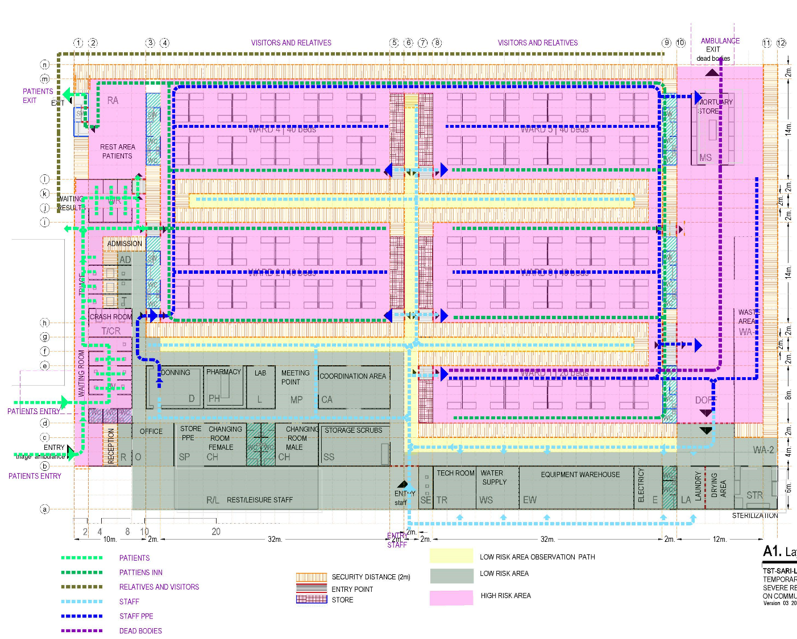
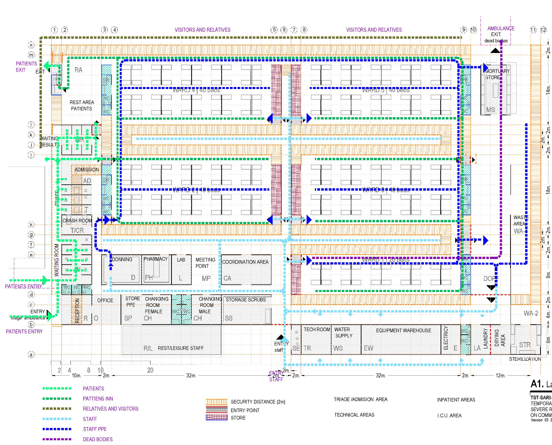
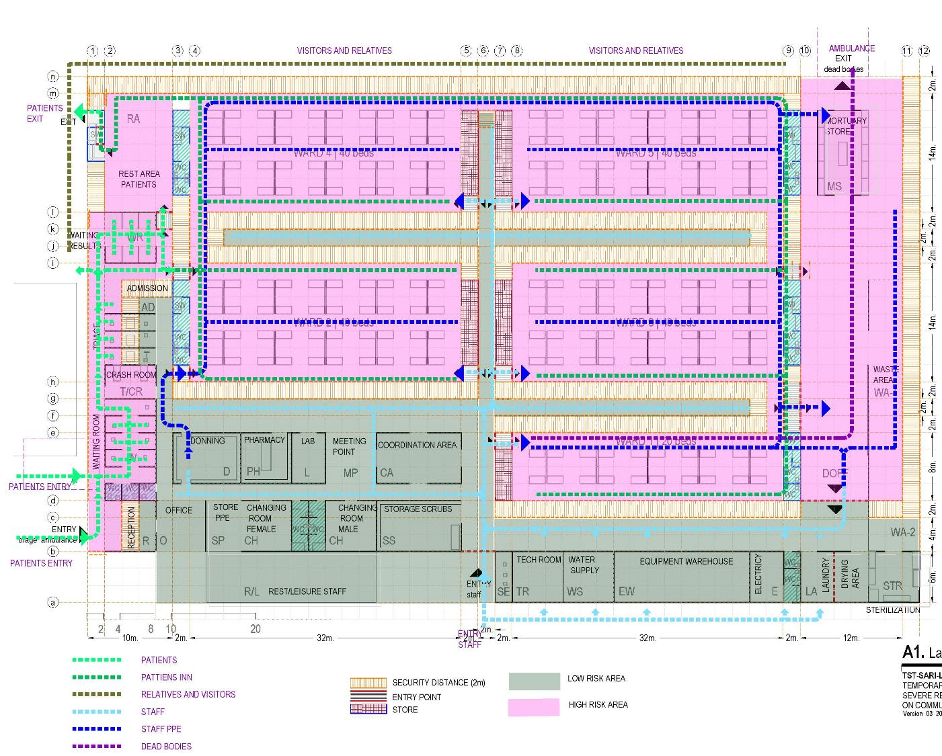
Site Plan
Notes:
Short summary Patient’s Pathway 2
Where are you on the site, what are the main areas

Slide 7
Patient’s Pathway
Ward
Daily routine
Oxygen therapy
Warning signs
Notes:
Short summary Patient’s Pathway 3

Slide 8
Site Plan
Notes:
Short summary Patient’s Pathway 4
Contaminated zones!

Slide 9
Patient’s Pathway
ICU
Ventilation
Airway access
Nursing
Nutrition
Notes:
Short summary Patient’s Pathway 5

Slide 10
Leaving the Facility
Discharged
Transferred
Dead
Notes:
Short summary Patient’s Pathway 6

Slide 11
Dilemmas in COVID treatment
Exercise
Decisions on treatment limitations
Requests for non-validated treatment
Risk taking (PPE shortage)
…………….
Notes:
Start Exercise 1: 3-4 groups, 10 minutes work, 1 minute reporting each group

Slide 12
Dilemmas
Solving Mechanisms
SOP’s
Management Structure
Ad Hoc Committee
Personal Decision
Notes:
Conclusion of exercise 1

Slide 13
Admission ?
Triage
Testing
Resuscitation
* Contaminated?
Notes:
Patient’s pathway in detail 1

Slide 14
From Triage to
Ward
ICU
Other facility
Home
Notes:
Patient’s pathway in detail 2

Slide 15
Treatment Plan
needs to be:
Recorded
Approved (team and patient + family)
Implemented
Notes:
Patient’s pathway in detail 3

Slide 16
Ward Routine
Ward Rounds
Treatment (co-morbidity!)
Nursing
Warning Signs
* Contamination
Notes:
Patient’s pathway in detail 4

Slide 17
Site Plan
Notes:
Patient’s pathway in detail 5
Non-Contaminated Corridors: risk reducing and PPE efficient

Slide 18
Oxygen Therapy
5 – 15 l / min
Mask + Res
Target SpO2: 90%, unless…
Caution with HFNO and NIV
Beware of Secundary Infection
Notes:
Patient’s pathway in detail 6
High Flow Nasal Oxygen Non Invasive Ventilation

Slide 19
Physiotherapy
essential
not all hands-on
consider partial task shifting
Notes:
Patient’s pathway in detail 7

Slide 20
Clinical Support
Lab
Pharmacy
Imaging
Notes:
Patient’s pathway in detail 8

Slide 21
Resuscitation
protocol
equipment
PPE !
Notes:
Patient’s pathway in detail 9

Slide 22
Communication
Patient
Family
Visitors
Notes:
Patient’s pathway in detail 10

Slide 23
ICU
Criteria
Ventilation
Sepsis
Notes:
Patient’s pathway in detail 11

Slide 24
Intubation
It’s an AGP !
Orotracheal tube (vs supraglottic pre-hosp)
Drug Assisted Intubation (RSI)
Skill ! (no task shifting)
Notes:
Patient’s pathway in detail 12
Aerosol Generating Procedure

Slide 25
Surgical Airway
It’s an AGP !
Percutaneous vs Open Method
Timing (later, non-infectious)
Skill ! (no task shifting)
Notes:
Patient’s pathway in detail 13
Aerosol Generating Procedure

Slide 26
Ventilation
Sedation
low Tidal Vol
low Insp Pressure
Early moderate PEEP
Permissive Hypercapnia
Prevent moments of interruption
12-16 hours prone position
Notes:
Patient’s pathway in detail 14

Slide 27
ICU more
Adequate Fluid Volume
Sepsis / MOF
Anti-Coagulation
Nutrition (enteral)
Notes:
Patient’s pathway in detail 15

Slide 28
Extubation
Easier Weaning with Tracheostomy
Not too early (high re-intubation rate)
Notes:
Patient’s pathway in detail 16

Slide 29
Ending Treatment Decision
Ethical Committee
Communication with family
Respect patient’s wish (if recorded)
Notes:
Patient’s pathway in detail 17

Slide 30
End of treatment
3 ways out
Home
Transfer
Dead
Notes:
Patient’s pathway in detail 18

Slide 31
Patient died
Procedures
Family
Mortuary, body bag
Notes:
Patient’s pathway in detail 19

Slide 32
PPE
Long-sleeved disposable fluid repellent gown or cover-all
Filtering face piece FFP 3 respirator
Full-face shield or visor
Gloves
Notes:
General Considerations 1

Slide 33
AGP
In/extubation + related
Tracheostomy + related
Bronchoscopy
Surg/post-mortem/dental where high speed devices
Non Invasive Ventilation, High Freq Osc Vent
Sputum manipulation
Notes:
General Considerations 2
Aerosol Generating Procedure list from NHS Scotland: Tracheostomies added, and Cardiac Resuscitation removed

Slide 34
4 Crucial Questions
Before every procedure
SOP ?
Required staff, + who is responsible ?
Required equipment incl PPE ?
Where (site map) ?
Notes:
General Considerations 3

Slide 35
Task Shifting
Exercise
specialist tasks - no shifting
tasks requiring skills - shiftable with training
general tasks - easily shiftable
tasks with risks – non desirable shifts for certain staff
Notes:
Exercise 2 Task Shifting: 3-4 groups: list examples of different groups of task (non) shifts, 10 minutes work, 1 minute reporting each group

Slide 36
Summary 1
Patient’s Pathway
pre-admission
ward
ICU
discharge / rehabilitation
Notes:
Summary 1

Slide 37
Summary 2
Session Outcomes
Overview of requirements for treatment of the COVID patient on its pathway through the facility
Gaps in protocols, staffing, skills, equipment and site for the COVID specific treatment?
Task shifting opportunities and limitations
Awareness of required PPE for every procedure
Dilemmas in treatment of COVID patients
Notes:
Summary 2

Slide 38
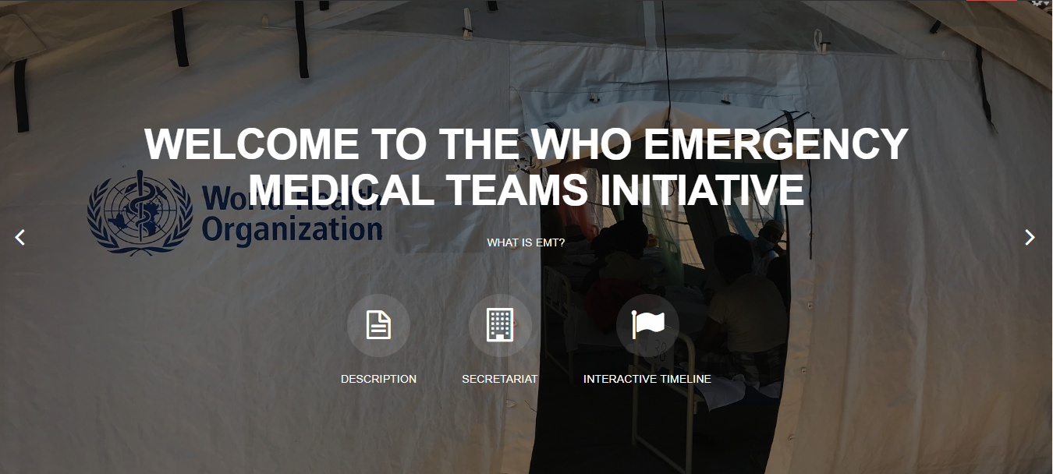
For more…
http://extranet.who.int/emt/
EMTeams@who.int
Notes:
Final slide

